Slide 1


FIN270 FINAL PROJECT
Siying Chen

Slide 2
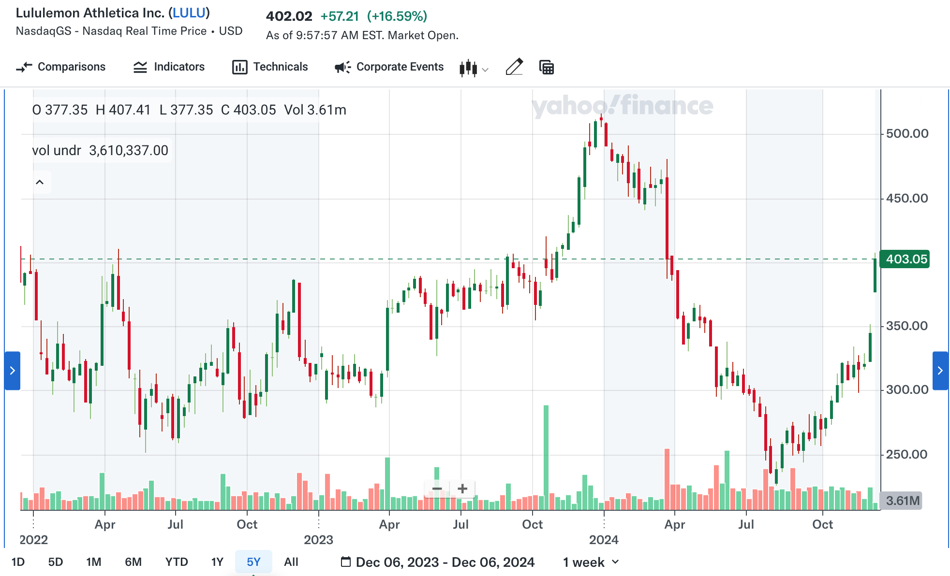
Lululemon Athletica Inc. (LULU)
Founded: 1998, in Vancouver, Canada.
Industry: Athletic Apparel and Lifestyle Retail.
Target Customers: Fitness enthusiasts/ High-income Consumers

Slide 3
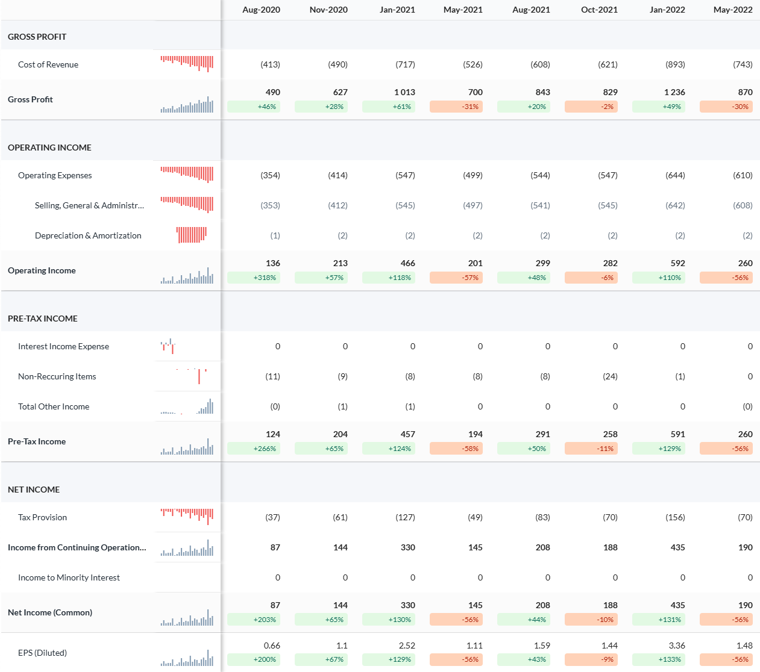
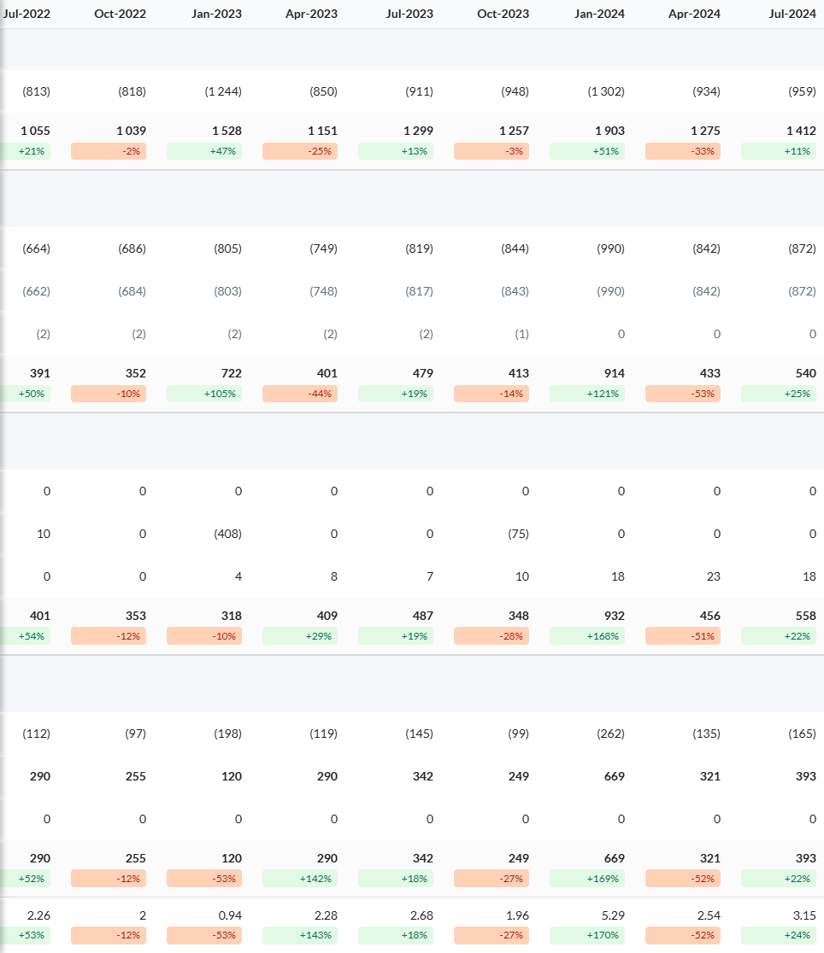

Slide 4
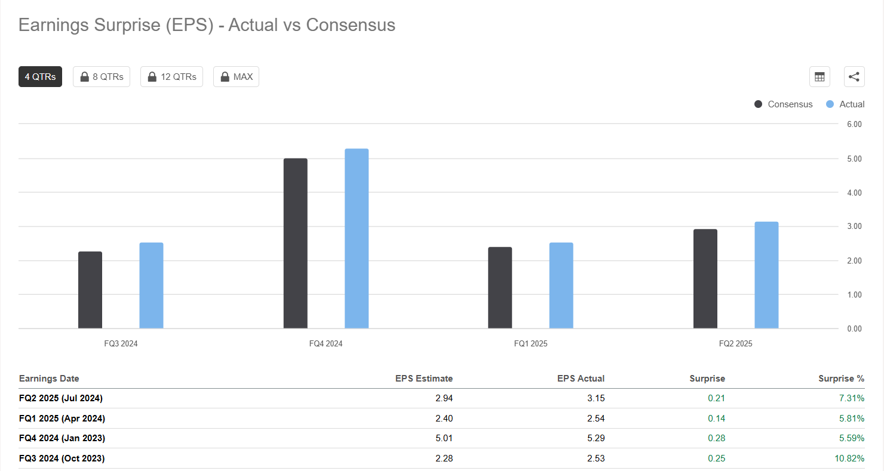
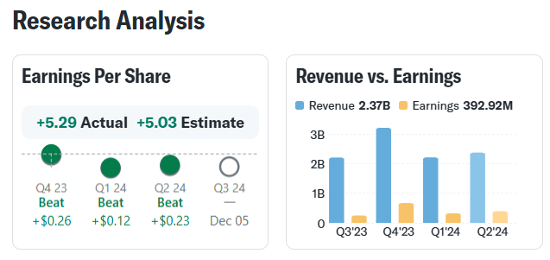
Earning Surprise (Positive)
Fig 1: Yahoo Finance
Fig 2: Seeking Alpha

Slide 5
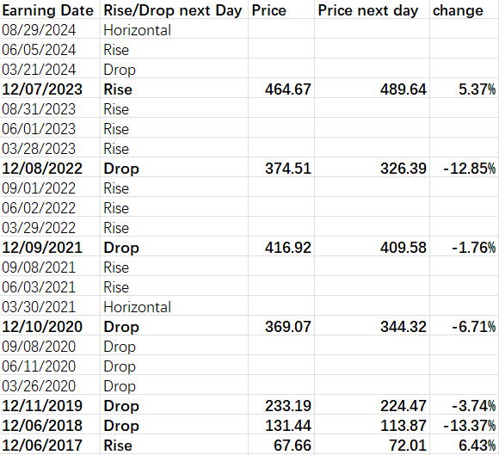
Option Strategy: Uneven Ratio Call Spread
Dec 2021: Lower Mirror sales guidance, high market expectations
Dec 2022: Rising inventory levels, declining profit margins, conservative holiday guidance
Dec 2023: Increase of international sales, moderate forward guidance
Dec 2024 (Prediction):
7% Year-Over-Year revenue and net income growth
Drop since this year
Strong Black Friday sales
Potential risks from lack of product innovation
Conservative guidance

Slide 6

Option Strategy: Uneven Ratio Call Spread
2 long call contracts: $340
1 short call contract: $360
Profit: $239%

Slide 7
Part 2: Pricing Option
Black Scholes Model
Binomial tree model

Slide 8
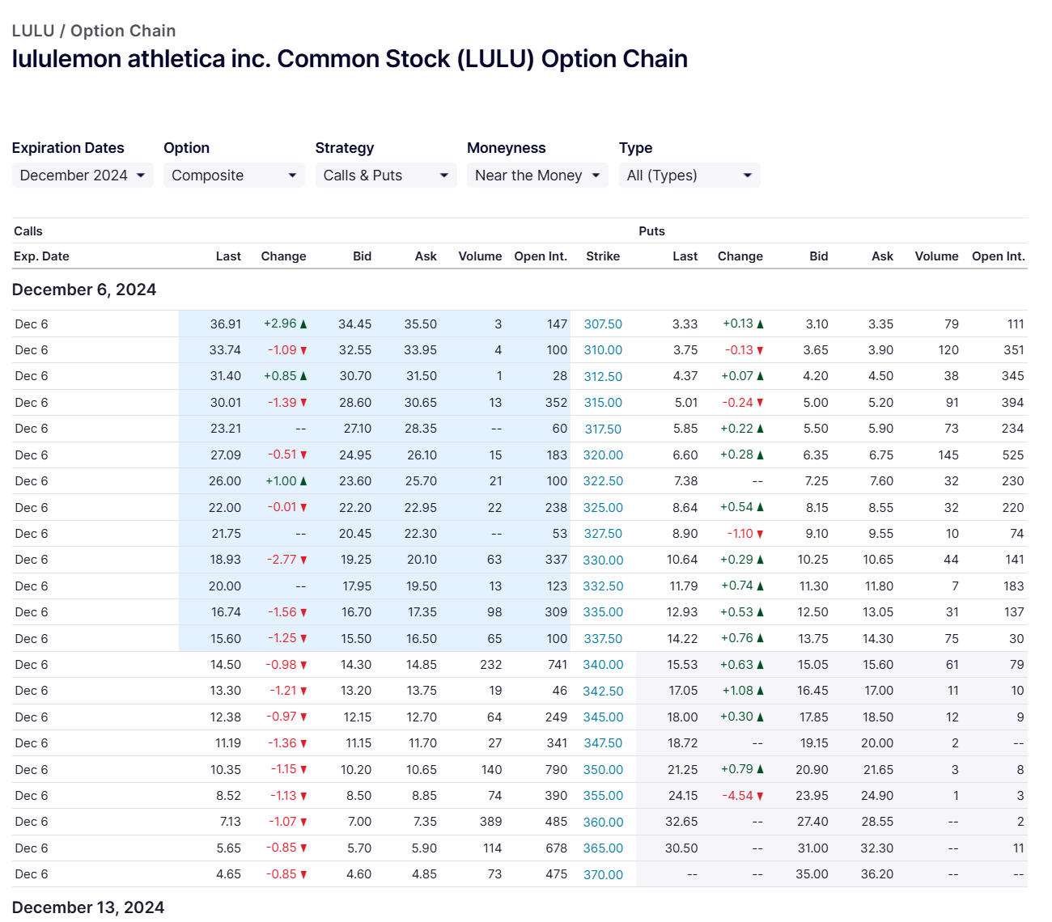
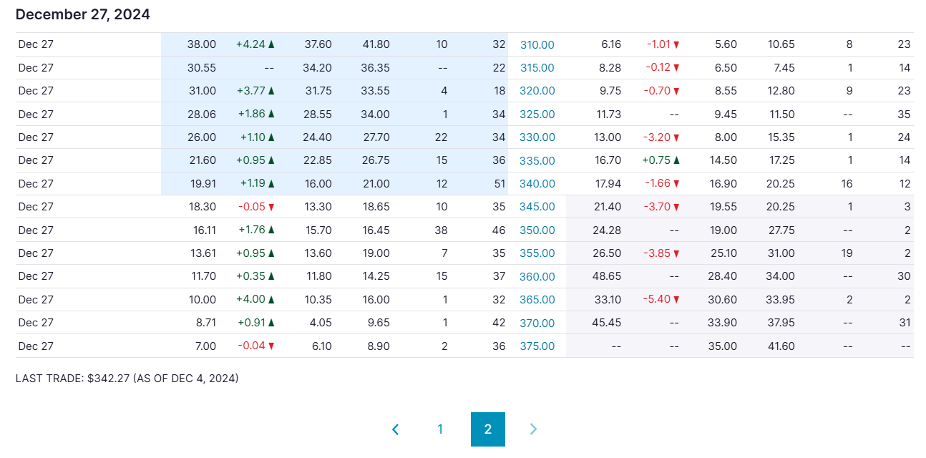
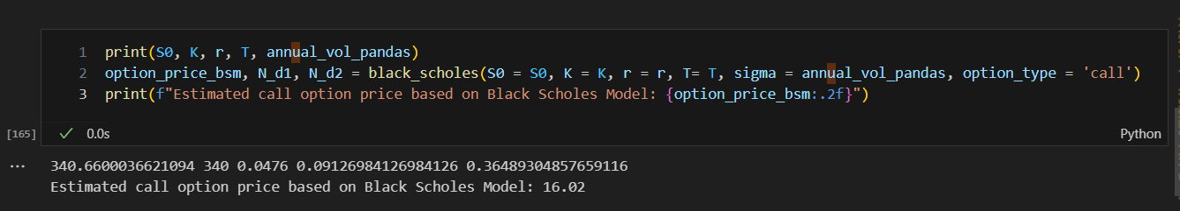
Black Scholes Model
Trade Date: Dec 4, 2024
Maturity Date: Dec 27, 2024
Closing Price (S0): 340.66 USD
Strike Price (K): 360 USD
Annualized Volatility (σ): 50.52%
1-month U.S. Treasury bill yield (rf): 4.76% (as of Nov 29, 2024)
Time(T): 23/252
Option Price: 21.74 USD

Slide 9
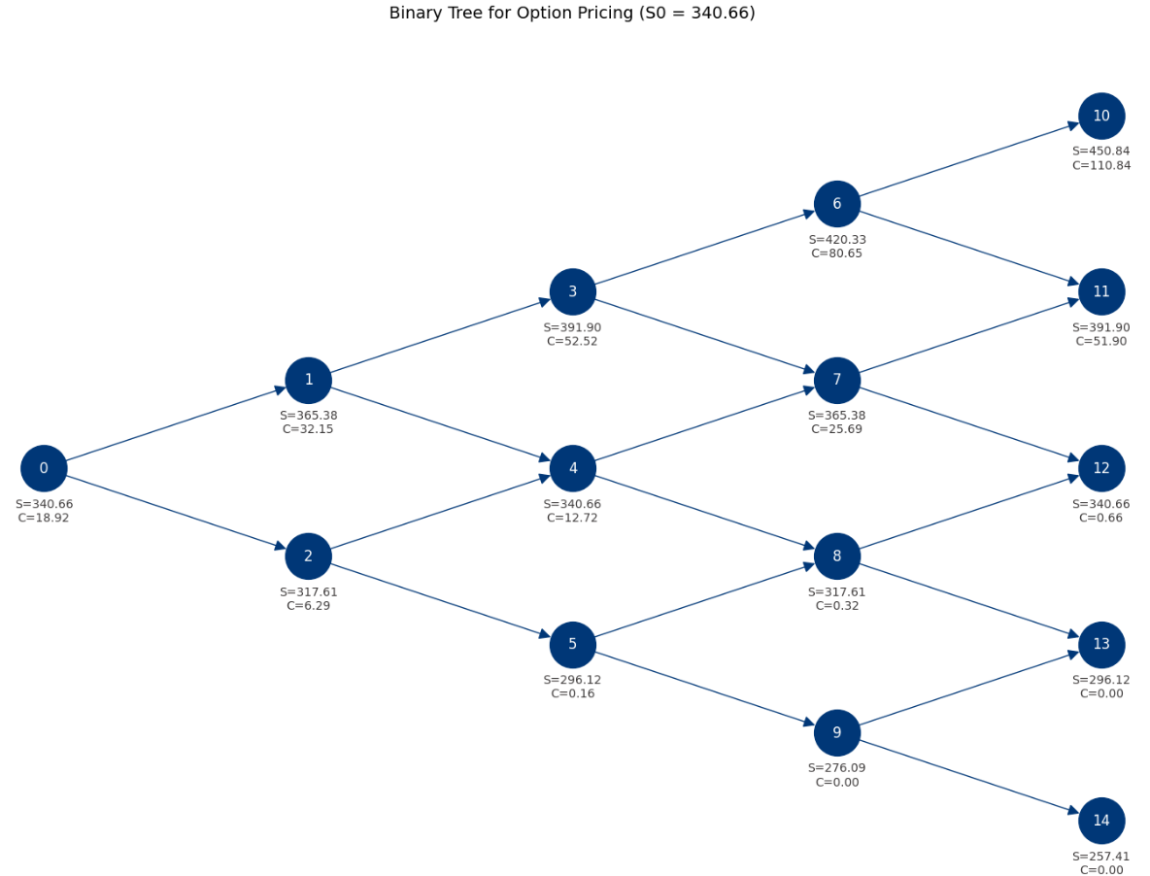
Binomial Tree Model
Trade Date: Dec 4, 2024
Maturity Date: Dec 27, 2024
Closing Price (S0): 340.66 USD
Annualized Volatility (σ): 50.52%
Upward price multiplier(u): 1.05
Downward price multiplier(d): 0.95
Discount Factor: 0.9991
Time(T): 23/252
N: 4
Option Price: 18.92 USD

Slide 10

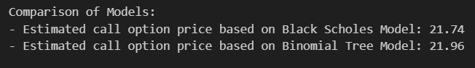
Part 2: Pricing Option
Difference:
Time Value
Implied volatility increased near earning day
Risk free rate
BTM > BSM ? Daily step result

Slide 11
Reference
https://seekingalpha.com/symbol/LULU/earnings/eps-surprise-summary?period=quarterly
https://finance.yahoo.com/quote/LULU/analysis/
https://www.alphaspread.com/security/nasdaq/lulu/financials/income-statement
https://www.investopedia.com/what-wall-street-analysts-think-lululemon-stock-earnings-8753898?utm_source=chatgpt.com

Slide 12
Thank you!
THANK YOU

Slide 13
Dec 4th
Closing Price: 342.27 USD

Slide 14
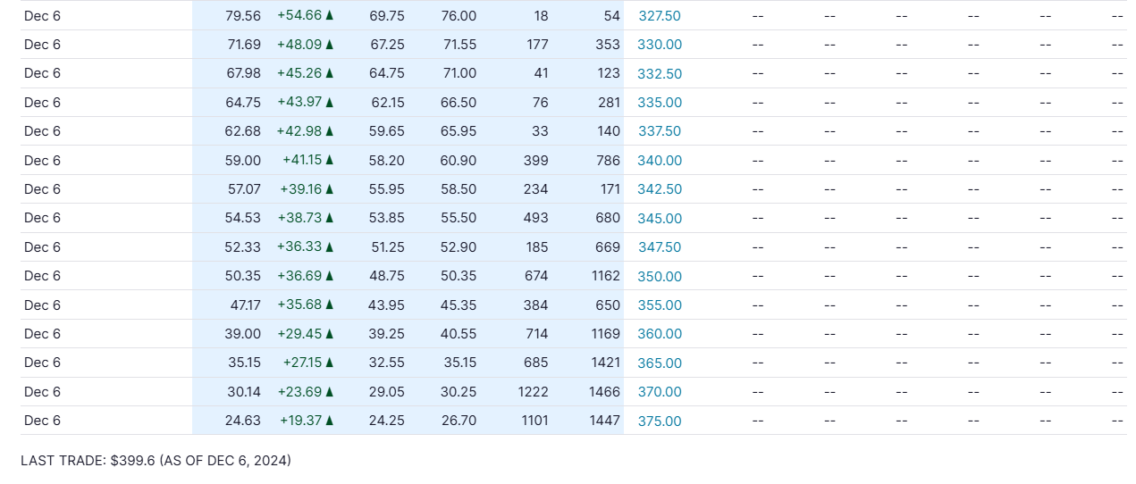
Dec 6th
Closing Price: 399.6USD

